Slide 1

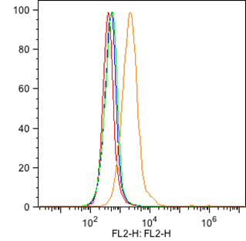
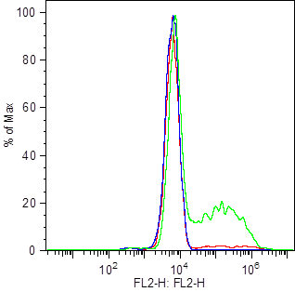
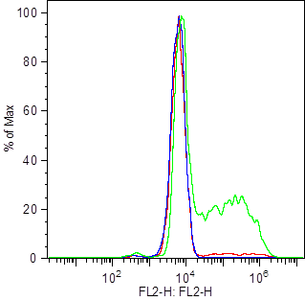



ReliaTech GmbH
Mouse anti-human VEGFR-2/KDR
(Cat #101-M20 / 101-M22)
#101-M20
EPCs
#101-M20
EPCs
#101-M22
Fig. 1: FACS analysis of VEGFR-2/KDR expression in HUVE cells (left panel) and EPCs derived from PBMcs (lower level ) [5μg/ml #101-M20 / -M22; 5μg/ml PE goat anti-mouse IgG].
The experiment was performed by Trisha M. Westerhof, University of California, Irvine.
http://www.reliatech.de / orders@reliatech.de

